Slide 1
The Definitive Presentation
of

Slide 2
Table of Contents
MongoDB Overview
Data Model & Query Capability
HA via Replication
Scalability via Sharding
Performances
Deployment Architecture
Security Considerations
Big Data & Analytics Integrations
Competitive Information
Operations

Slide 3
MongoDB Overview

Slide 4
About MongoDB, Inc.
500+ employees
13 offices worldwide
2,000+ customers
$311M in funding

Slide 5





















MongoDB Use Cases
Single View
Internet of Things
Mobile
Real-Time Analytics
Catalog
Personalization
Content Management

Slide 6
Expanded Use Case Coverage
Content Repo
IoT Sensor Backend
Ad Service
Customer Analytics
Archive
Security
MongoDB Query Language (MQL) + Native Drivers
Management
MongoDB Document Data Model
WT
MMAP
In-memory
Encrypted
3rd party
Supported in MongoDB 3.2

Slide 7
























































Slide 8

Fortune 500 & Global 500
40 of the Top Financial Services Institutions
15 of the Top Retailers
15 of the Top Telcos
15 of the Top Technology Companies
15 of the Top Healthcare Companies
10 of the Top Electronics Companies
10 of the Top Media and Entertainment Companies

Slide 9
4th Most Popular, Fastest Growing
RANK | DBMS | MODEL | SCORE | GROWTH (20 MO)
1. | Oracle | Relational DBMS | 1,442 | -5%
2. | MySQL | Relational DBMS | 1,294 | 2%
3. | Microsoft SQL Server | Relational DBMS | 1,131 | -10%
4. | MongoDB | Document Store | 277 | 172%
5. | PostgreSQL | Relational DBMS | 273 | 40%
6. | DB2 | Relational DBMS | 201 | 11%
7. | Microsoft Access | Relational DBMS | 146 | -26%
8. | Cassandra | Wide Column | 107 | 87%
9. | SQLite | Relational DBMS | 105 | 19%
Source: DB-engines database popularity rankings; May 2015

Slide 10
Gartner, Inc. recognized
MongoDB as a Leader
in the 2015 Magic Quadrant for
Operational Database Management Systems.*
*Gartner, Inc., Magic Quadrant for Operational Database Management Systems by Donald Feinberg, Merv Adrian, Nick Heudecker, Adam M. Ronthal, and Terilyn Palanca, October 12, 2015.
*Gartner does not endorse any vendor, product or service depicted in its research publications, and does not advise technology users to select only those vendors with the highest ratings or other designation. Gartner research publications consist of the opinions of Gartner's research organization and should not be construed as statements of fact. Gartner disclaims all warranties, expressed or implied, with respect to this research, including any warranties of merchantability or fitness for a particular purpose.
This graphic was published by Gartner, Inc. as part of a larger research document and should be evaluated in the context of the entire document. The Gartner document is available upon request from MongoDB, Inc.

Slide 11
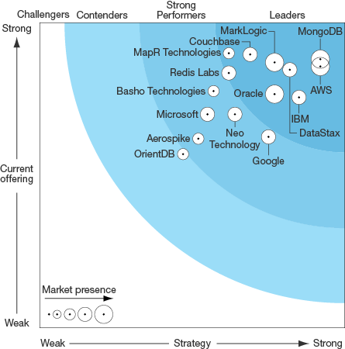
MongoDB named a leader in The Forrester Wave™: Big Data NoSQL, Q3 2016
Achieving the highest possible scores in 19 of the 26 criteria, MongoDB believes that this report indicates its strength and versatility as an all-purpose database for a variety of mission-critical use cases.
5 out of 5 Points for:
Data Types
Streaming and Loading
Big Data Support
In-memory
Performance
Scalability
High Availability & Disaster Recovery
Tools
Workloads
Use Cases
Ability to Execute
Road Map
Open Source and Licensing
Support
The Forrester Wave™ is copyrighted by Forrester Research, Inc. Forrester and Forrester Wave are trademarks of Forrester Research, Inc. The Forrester Wave is a graphical representation of Forrester's call on a market and is plotted using a detailed spreadsheet with exposed scores, weightings, and comments. Forrester does not endorse any vendor, product, or service depicted in the Forrester Wave. Information is based on best available resources. Opinions reflect judgment at the time and are subject to change.
Notes:
These slides have been approved by Forrester. They cannot be used in negative/comparative presentation contexts against other companies.
Any questions, please email marissa@mongodb.com.

Slide 12

The Largest Ecosystem
20,000,000+ MongoDB Downloads
400,000+ Online Education Students
40,000+ MongoDB Cloud Manager Users
35,000+ MongoDB User Group Members
1,000+ Technology and Services Partners
2,000+ Customers Across All Industries
Notes:
Massive and Fast Growing Ecosystem
Access to fastest growing talent pool & give your developers a technology that they want to work with
Reliable partner for the future
Most revenue, users, customers and partners in non-relational market

Slide 13
How We Can Help
Tooling
Security
License
Support
Services
Notes:
We offer a comprehensive suite of solutions and services to help you succeed with your MongoDB deployment. They include:
Enterprise tooling enables your teams to operationalize MongoDB more efficiently. This includes monitoring, performance optimization, automation, & backup. Other products include a MongoDB GUI to make MongoDB accessible to your wider organization, a connector to your SQL-based BI platforms, and more.
Enterprise security – we make it easier for you to protect your data and / or build compliant applications.
Commercial License to help you protect your investments.
Support – 24 x 7 enterprise-grade support from the same team that builds the database
Services – specialized professional services packages for all teams throughout your development lifecycle, from design to production.

Slide 14
Flexible Data Model

Slide 15
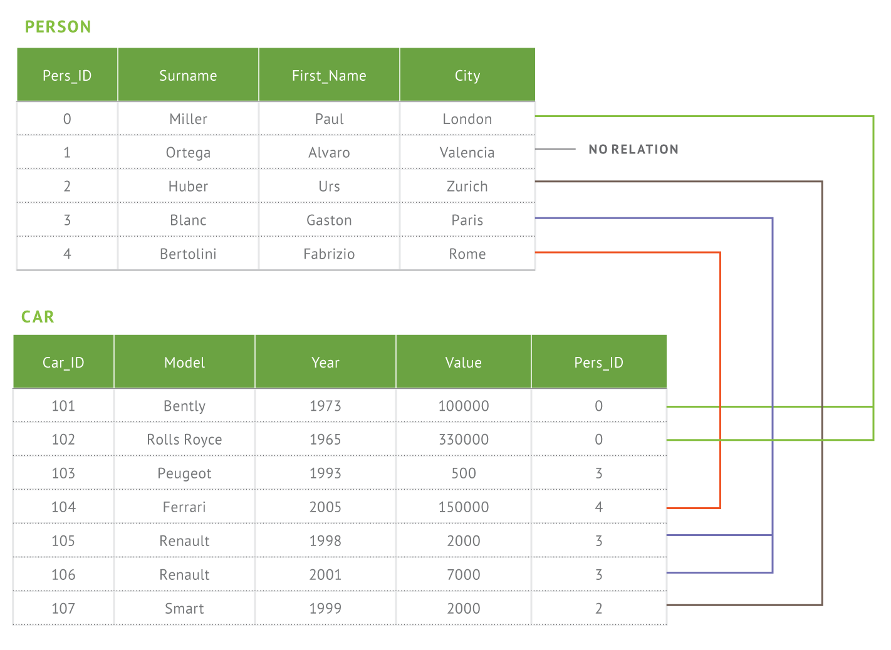
Document Model
RDBMS
MongoDB
{
first_name: ‘Paul’,
surname: ‘Miller’,
city: ‘London’,
location: [45.123,47.232],
cars: [
{ model: ‘Bentley’,
year: 1973,
value: 100000, … },
{ model: ‘Rolls Royce’,
year: 1965,
value: 330000, … }
]
}
Notes:
Here we have greatly reduced the relational data model for this application to two tables. In reality no database has two tables. It is much more common to have hundreds or thousands of tables. And as a developer where do you begin when you have a complex data model?? If you’re building an app you’re really thinking about just a hand full of common things, like products, and these can be represented in a document much more easily that a complex relational model where the data is broken up in a way that doesn’t really reflect the way you think about the data or write an application.
Document Model Benefits
Agility and flexibility
Data model supports business change
Rapidly iterate to meet new requirements
Intuitive, natural data representation
Eliminates ORM layer
Developers are more productive
Reduces the need for joins, disk seeks
Programming is more simple
Performance delivered at scale

Slide 16
Documents are Rich Data Structures
{
first_name: ‘Paul’,
surname: ‘Miller’,
cell: 447557505611,
city: ‘London’,
location: [45.123,47.232],
Profession: [‘banking’, ‘finance’, ‘trader’],
cars: [
{ model: ‘Bentley’,
year: 1973,
value: 100000, … },
{ model: ‘Rolls Royce’,
year: 1965,
value: 330000, … }
]
}
String
Number
Typed field values
Geo-Location
Fields
Fields can contain arrays
Fields can contain an array
of sub-documents

Slide 17
Documents are Flexible
Documents in the same product catalog collection in MongoDB
{
product_name: ‘Acme Paint’,
color: [‘Red’, ‘Green’],
size_oz: [8, 32],
finish: [‘satin’, ‘eggshell’]
}
{
product_name: ‘T-shirt’,
size: [‘S’, ‘M’, ‘L’, ‘XL’],
color: [‘Heather Gray’ … ],
material: ‘100% cotton’,
wash: ‘cold’,
dry: ‘tumble dry low’
}
{
product_name: ‘Mountain Bike’,
brake_style: ‘mechanical disc’,
color: ‘grey’,
frame_material: ‘aluminum’,
no_speeds: 21,
package_height: ‘7.5x32.9x55’,
weight_lbs: 44.05,
suspension_type: ‘dual’,
wheel_size_in: 26
}

Slide 18















Drivers & Frameworks
MEAN Stack
Morphia

Slide 19

Development – The Past
{ CODE }
XML CONFIG
DB SCHEMA
APPLICATION
OBJECT RELATIONAL MAPPING
RELATIONAL DATABASE

Slide 20
Development – With MongoDB
{ CODE }
XML CONFIG
DB SCHEMA
APPLICATION
OBJECT RELATIONAL MAPPING
RELATIONAL DATABASE

Slide 21
Data Governance

Slide 22
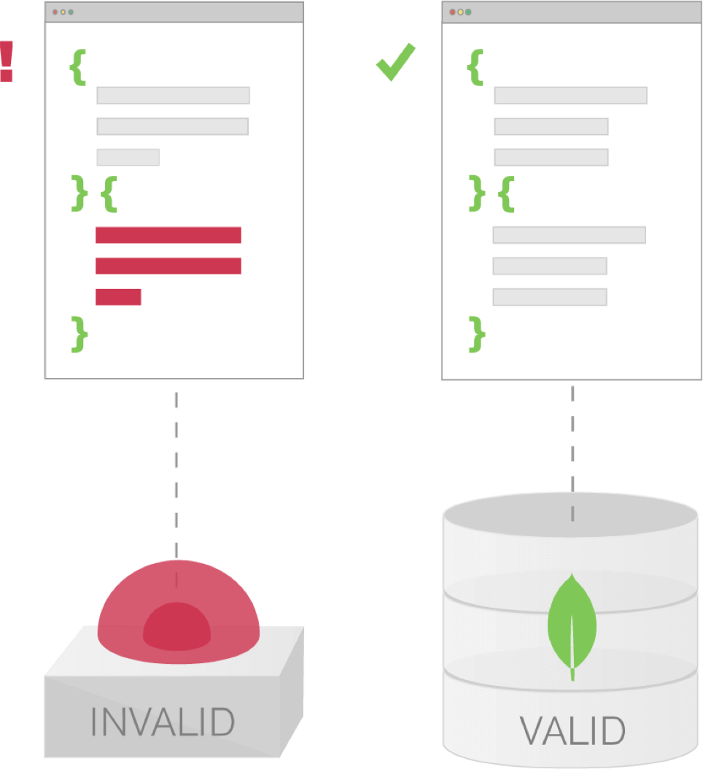
Data Governance: Document Validation
Implement data governance without sacrificing the agility that comes from a dynamic schema
Notes:
Dynamic schemas bring great agility, but it is also important that controls can be implemented to maintain data quality, especially if the database is powering multiple applications, or is integrated into a larger data management platform that feeds into upstream and downstream systems. Rather than delegating enforcement of these controls back into application code, MongoDB provides Document Validation within the database.
Enforce data quality across multiple teams and applications
Use familiar MongoDB expressions to control document structure
Validation is optional and can be as simple as a single field, all the way to every field, including existence, data types, and regular expressions
Much more flexible than the implementations of data governance you’ll find in relational databases

Slide 23
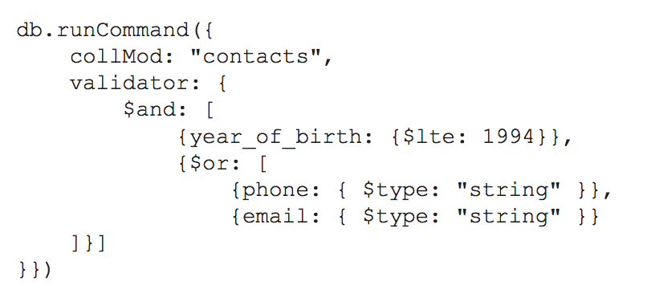
Document Validation Example
Notes:
The example above adds a rule to the contacts collection that validates:
The year of birth is no later than 1994
The document contains a phone number and / or an email address
When present, the phone number and email addresses are strings

Slide 24
Expressive Query Language & Secondary Indexes

Slide 25
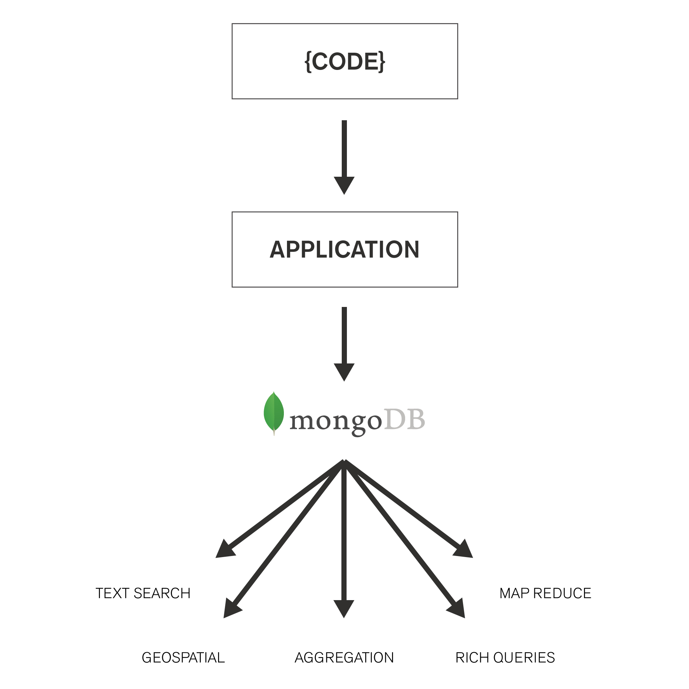
MongoDB is Full-Featured
Rich Queries | Find Paul’s cars Find everybody in London with a car between 1970 and 1980
Geospatial | Find all of the car owners within 5km of Trafalgar Sq.
Text Search | Find all the cars described as having leather seats
Aggregation | Calculate the average value of Paul’s car collection
Map Reduce | What is the ownership pattern of colors by geography over time (is purple trending in China?)
Notes:
Rich queries, text search, geospatial, aggregation, mapreduce are types of things you can build based on the richness of the query model.

Slide 26

Dynamic Lookup
Combine data from multiple collections with left outer joins for richer analytics & more flexibility in data modeling
Notes:
Blend data from multiple sources for analysis
Higher performance analytics with less application-side code and less effort from your developers
Executed via the new $lookup operator, a stage in the MongoDB Aggregation Framework pipeline

Slide 27
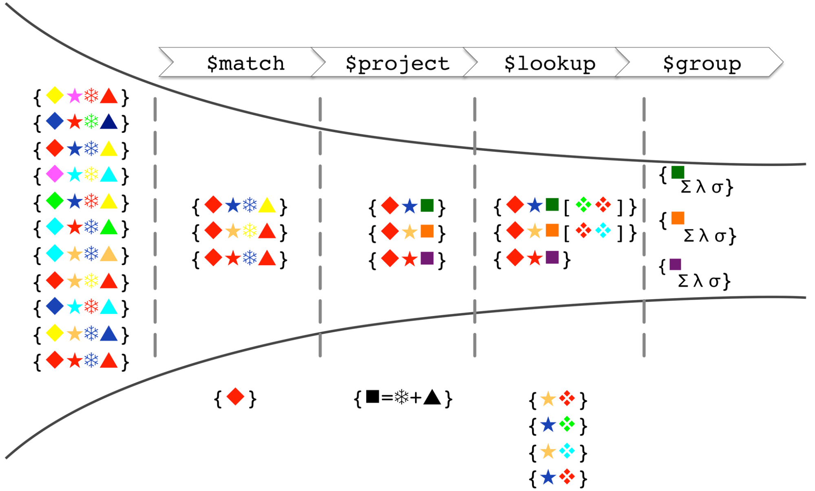
Model of the Aggregation Framework
Notes:
Start with the original collection; each record (document) contains a number of shapes (keys), each with a particular color (value)
$match filters out documents that don’t contain a red diamond
$project adds a new “square” attribute with a value computed from the value (color) of the snowflake and triangle attributes
$lookup performs a left outer join with another collection, with the star being the comparison key
Finally, the $group stage groups the data by the color of the square and produces statistics for each group

Slide 28
Richer In-Database Analytics & Search
New Aggregation operators extend options for performing analytics with lower developer complexity
Array Operators | Math Operators | Text
$slice, $arrayElemAt, $concatArrays,$filter, $min, $max, $avg, $sum, and more. | $stdDevSamp, $stdDevPop, $sqrt,$abs, $trunc, $ceil,$floor, $log, $pow $exp, and more. | Case sensitive text search and support for languages such as Arabic, Farsi, Chinese, and more.

Slide 29
High Availability & Uptime

Slide 30
Replica Sets
Replica set – 2 to 50 copies
Replica sets make up a self-healing ‘shard’
Data center awareness
Replica sets address:
High availability
Data durability, consistency
Maintenance (e.g., HW swaps)
Disaster Recovery
Application
Driver
Primary
Secondary
Replication
Secondary
Notes:
High Availability – Ensure application availability during many types of failures
Meet stringent SLAs with fast-failover algorithm
Under 2 seconds to detect and recover from replica set primary failure
Disaster Recovery – Address the RTO and RPO goals for business continuity
Maintenance – Perform upgrades and other maintenance operations with no application downtime
Secondaries can be used for a variety of applications – failover, hot backup, rolling upgrades, data locality and privacy and workload isolation

Slide 31

Replica Sets – Workload Isolation
Replica sets enable workload isolation
Example: Operational workloads on the primary node, analytical workloads on the secondary nodes
eCommerce Application
User Data
Sessions, Cart,
Recommendations
MongoDB Primary
In-memory Storage Engine
Persisted
User Data
MongoDB Secondary
WiredTiger Storage Engine
MongoDB Secondary
WiredTiger Storage Engine

Slide 32
Replica Set Creation
Node 1
Node 2
Node 3

Slide 33
Replica Set - Initialize
Node 1
(Primary)
Replication
Replication
Heartbeat
Node 2
(Secondary)
Node 3
(Secondary)

Slide 34
Replica Set - Failure
Node 1
(Primary)
Node 2
(Secondary)
Primary Election
Node 3
(Secondary)
Heartbeat

Slide 35
Replica Set - Failover
Node 1
(Primary)
Replication
Node 2
(Primary)
Node 3
(Secondary)
Heartbeat

Slide 36
Replica Set - Recovery
Node 1
(Recovery)
Replication
Heartbeat
Node 2
(Primary)
Node 3
(Secondary)
Replication

Slide 37
Replica Set - Recovered
Node 1
(Secondary)
Replication
Heartbeat
Node 2
(Primary)
Node 3
(Secondary)
Replication

Slide 38
Strong Consistency
Application
Driver
Read and write
Node 1
(Primary)
Node 2
(Secondary)
Node 3
(Secondary)

Slide 39
Strong Consistency
Application
Driver
Read and write
Node 1
(Primary)
Read
Read
Node 2
(Secondary)
Node 3
(Secondary)

Slide 40
Elastic Scalability

Slide 41
Elastic Scalability: Automatic Sharding
Increase or decrease capacity as you go
Automatic load balancing
Three types of sharding
Hash-based
Range-based
Tag-aware
Horizontally Scalable
Shard 1
Shard 2
Shard 3
Shard N
Notes:
MongoDB provides horizontal scale-out for databases using a technique called sharding, which is trans- parent to applications. Sharding distributes data across multiple physical partitions called shards. Sharding allows MongoDB deployments to address the hardware limitations of a single server, such as bottlenecks in RAM or disk I/O, without adding complexity to the application.
MongoDB automatically balances the data in the cluster as the data grows or the size of the cluster increases or decreases.
MongoDB supports three types of sharding:
• Range-based Sharding. Documents are partitioned across shards according to the shard key value. Documents with shard key values “close” to one another are likely to be co-located on the same shard. This approach is well suited for applications that need to optimize range- based queries.
• Hash-based Sharding. Documents are uniformly distributed according to an MD5 hash of the shard key value. Documents with shard key values “close” to one another are unlikely to be co-located on the same shard. This approach guarantees a uniform distribution of writes across shards, but is less optimal for range-based queries.
• Tag-aware Sharding. Documents are partitioned according to a user-specified configuration that associates shard key ranges with shards. Users can optimize the physical location of documents for application requirements such as locating data in specific data centers.

Slide 42
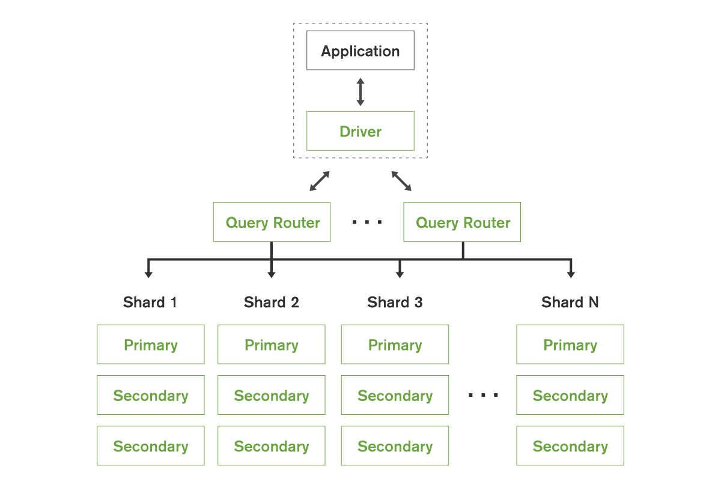
Query Routing
Multiple query optimization models
Each of the sharding options are appropriate for different apps / use cases
Notes:
Sharding is transparent to applications; whether there is one or one hundred shards, the application code for querying MongoDB is the same. Applications issue queries to a query router that dispatches the query to the appropriate shards.
For key-value queries that are based on the shard key, the query router will dispatch the query to the shard that manages the document with the requested key. When using range-based sharding, queries that specify ranges on the shard key are only dispatched to shards that contain documents with values within the range. For queries that don’t use the shard key, the query router will dispatch the query to all shards and aggregate and sort the results as appropriate. Multiple query routers can be used with a MongoDB system, and the appropriate number is determined based on performance and availability requirements of the application.

Slide 43
Designed for Performance
Better Data Locality
In-Memory Caching
In-Place Updates

Slide 44
Performance at Scale
 | Top 5 Marketing Firm | Government Agency | Top 5 Investment Bank
Data | Key / Value | 10+ fields, arrays, nested documents | 20+ fields, arrays, nested documents
Queries | Key – based 1-100 docs / query 80/20 read/write | Compound queries Range queries MapReduce 20/80 read/write | Compound queries Range queries 50/50 read/write
Servers | ~250 | ~50 | 4
Ops / Sec | 1,200,000 | 500,000 | 30,000
Notes:
The figures above are examples. Your application will govern your performance.

Slide 45






Performance at Scale
Cluster Scale |  | Performance Scale |  | Data Scale
Entertainment Company | 1,400 servers |  | 250 Million Ticks / Sec |  | Petabytes
Asian Internet Company | 1,000+ servers |  | 300k Ops / Sec |  | 10s of billions of objects
 | 250+ servers | Federal Agency | 500k Ops / Sec |  | 200 billion documents / 1+ PB of data
Notes:
The figures above are examples. Your application will govern your performance.

Slide 46
Deployment Architectures

Slide 47
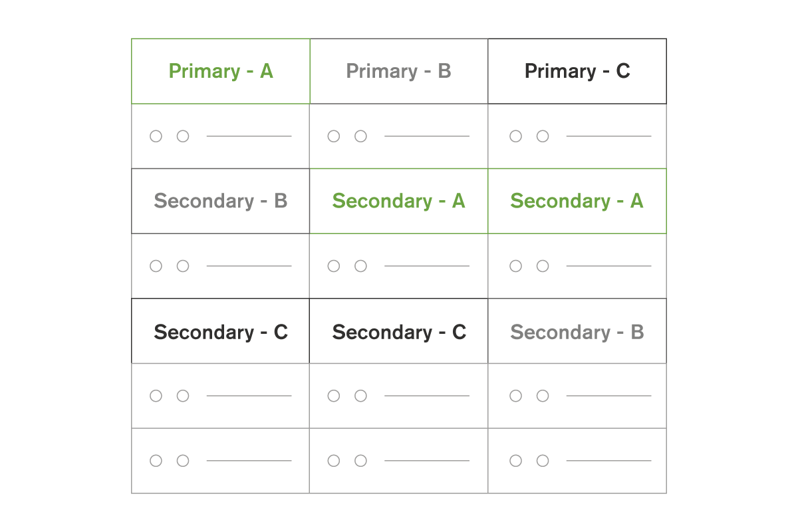
Single Data Center Deployment
Notes:
Automated failover
Tolerates server failures
Tolerates rack failures
Number of replicas defines failure tolerance

Slide 48
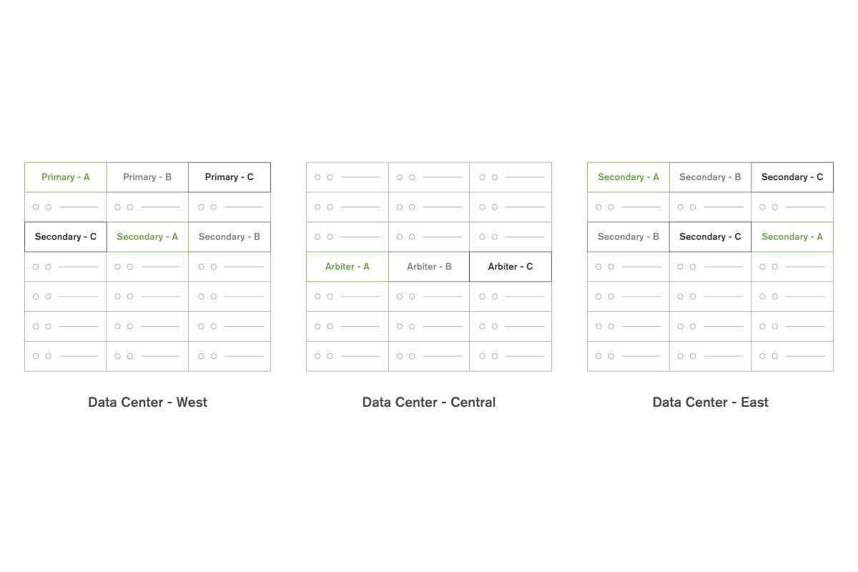
Active / Active Data Center
Notes:
Tolerates server, rack, data center failures, network partitions

Slide 49
Active / Standby Data Center
Notes:
Tolerates server and rack failure
Standby data center
Replicas in Data Center - East configured as secondary-only.

Slide 50
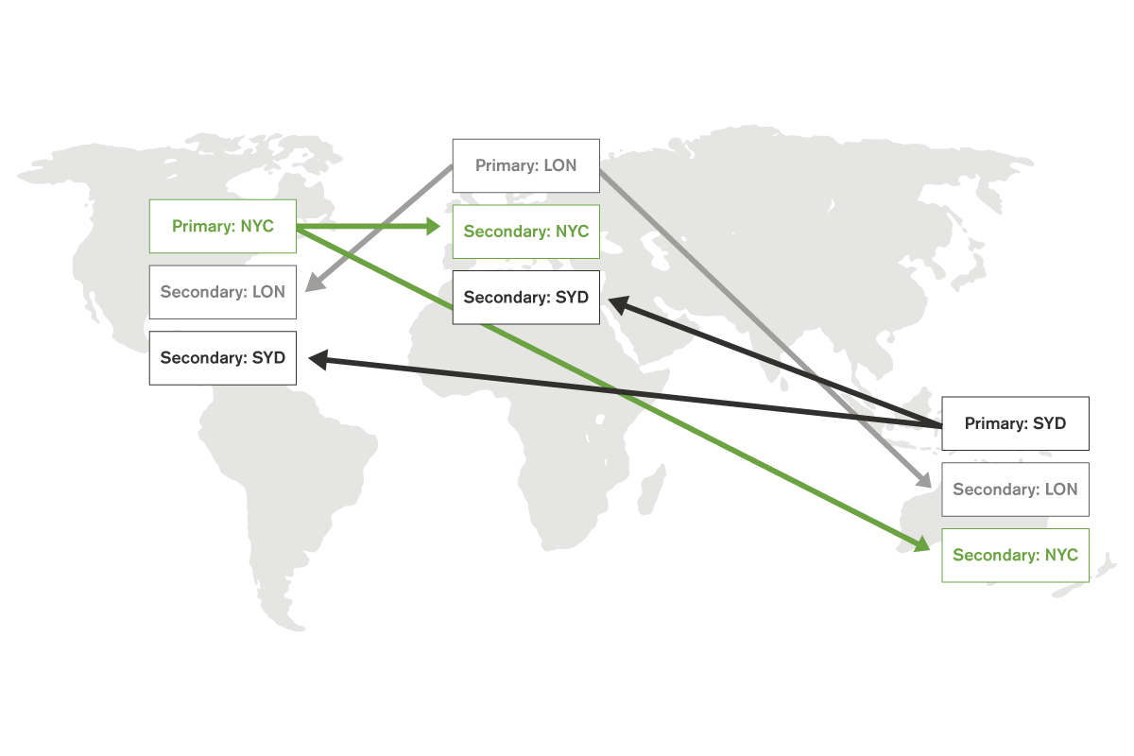
Deploy Global, Access Local

Slide 51
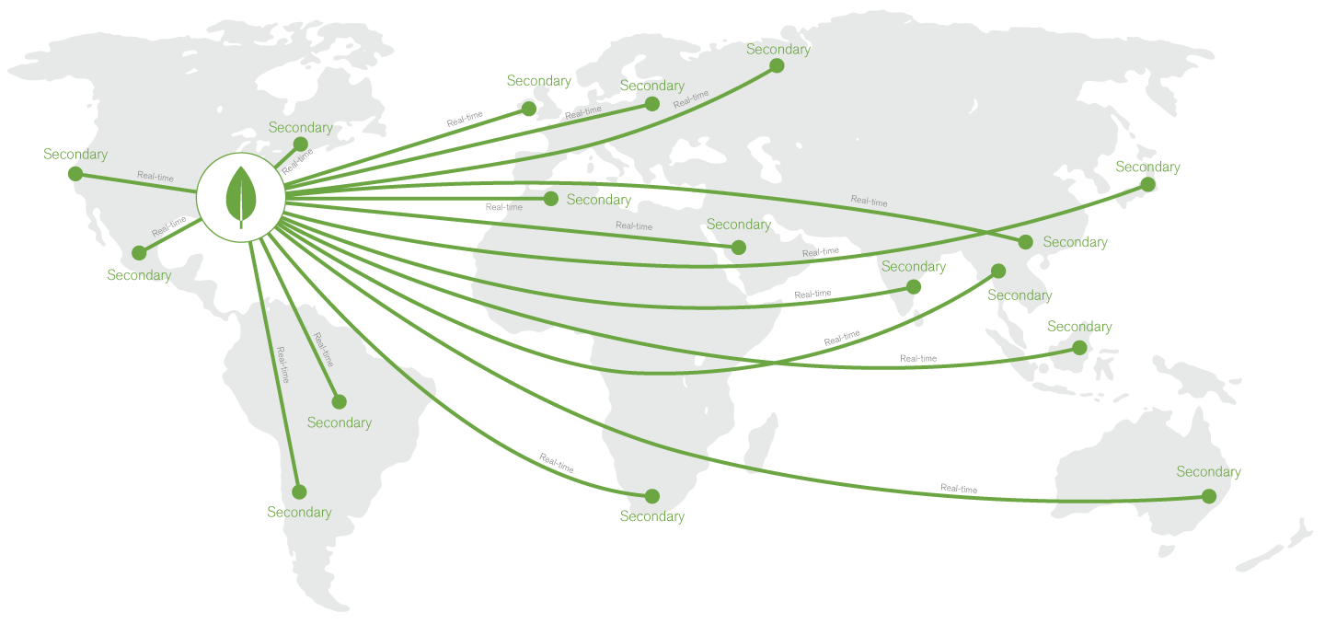
Replicate Data Near Users

Slide 52
Security

Slide 53
MongoDB Security Features
Business Needs | MongoDB Security Features
Authentication | SCRAM, LDAP*, Kerberos*, x.509 Certificates
Authorization | Built-in Roles, User-Defined Roles, Field-Level Redaction
Auditing* | Admin, DML, DDL, Role-Based
Encryption | Network: SSL (with FIPS 140-2*) Disk: Encrypted Storage Engine* or Partner Solutions
*Included with MongoDB Enterprise Advanced

Slide 54
Work with Hadoop/Spark & Analytics

Slide 55



MongoDB & Hadoop
Analysis
powered by
Applications
powered by
MongoDB Connector
For Hadoop
Notes:
MongoDB
Low latency
Rich fast querying
Flexible indexing
Ad hoc aggregations in database
Known data relationships
Great at looking at any subset of data
Hadoop
Longer jobs and queries
Analytical processing
Often highly partitionable
Unknown data relationships
Great at looking at all of data

Slide 56







MongoDB in the Analytics Landscape
Batch / Predictive / Ad Hoc
(mins – hours)
Planned Reporting
(secs – mins )
Real-Time Dashboards / Scoring (<30 ms)
Emerging
Legacy

Slide 57

MongoDB Connector for Apache Spark
Analytics Application
Native Scala connector, certified by Databricks
Exposes all Spark APIs & libraries
Efficient data filtering with predicate pushdown, secondary indexes, & in-database aggregations
Locality awareness to reduce data movement
Scala, Java, Python, R APIs
SQL
Machine Learning Libraries
Streaming
Graph
MongoDB Connector for Spark
Spark Worker
Spark Worker
Spark Worker
Spark Worker
“We reduced 100+ lines of integration code to just a
single line after moving to the MongoDB Spark connector.”
- Early Access Tester, Multi-National Banking Group Group

Slide 58
Analytics Landscape
Response | Data Supported | Maturity | Analytical Capabilities | Ease of Use
Real-Time | ● | ◑ | ◑ | ◕
Batch | ● | ◑ | ◕ | ○
Batch | ◑ | ◑ | ◔ | ◑
Interactive | ◑ | ◔ | ◔ | ◑
Interactive | ● | ○ | ◑ | ○
Interactive | ◔ | ● | ● | ●

Slide 59









Analytics & BI Integration

Slide 60
MongoDB Connector for BI
Visualize and explore multi-structured data using SQL-based BI platforms.
Connector for BI
Provides Schema
Translates Queries
Translates Response
Notes:
MongoDB BI Connector…
Provides the BI tool with the schema of the MongoDB collection to be visualized
Translates SQL statements issued by the BI tool into equivalent MongoDB queries that are sent to MongoDB for processing
Converts the results into the tabular format expected by the BI tool, which can then visualize the data based on user requirements

Slide 61
Appendix – Comparison Charts vs. Key/Value, RDBMS

Slide 62
Data Model Comparison
 | MongoDB | Key/Value | Relational
Rich Data Model | Yes | No | No
Dynamic Schema | Yes | Yes | No
Typed Data | Yes | No | Yes
Data Locality | Yes | Yes | No
Field Updates | Yes | No | Yes
Easy for Programmers | Yes | Yes | No

Slide 63
Query Model Comparison
 | MongoDB | Key/Value | Relational
Key/Value | Yes | Yes | Yes
Secondary Indexes | Yes | No | Yes
Index Intersection | Yes | No | Yes
Range Queries | Yes | No | Yes
Geospatial | Yes | No | Yes
Text Search | Yes | No | Yes
Aggregation | Yes | No | Yes
MapReduce | Yes | Yes | No

Slide 64
Operational Capabilities Comparison
 | MongoDB | Key/Value | Relational
Automatic Failover | Yes | Limited | Yes
Data Center Awareness | Yes | No | Expensive Add-Ons
Continuous Backup | Yes | No | Yes
Point in Time Recovery | Yes | No | Yes
Caching Layer Needed | No | No | Often
Automatic Sharding | Yes | Yes | No

Slide 65
Appendix – GridFS

Slide 66
Store Large Files
Store files larger than 16 MB
Load chunks without reading entire file into memory
Atomically sync files with their metadata
Shard and distribute around the cluster

Slide 67
Management Platform and Tools

Slide 68
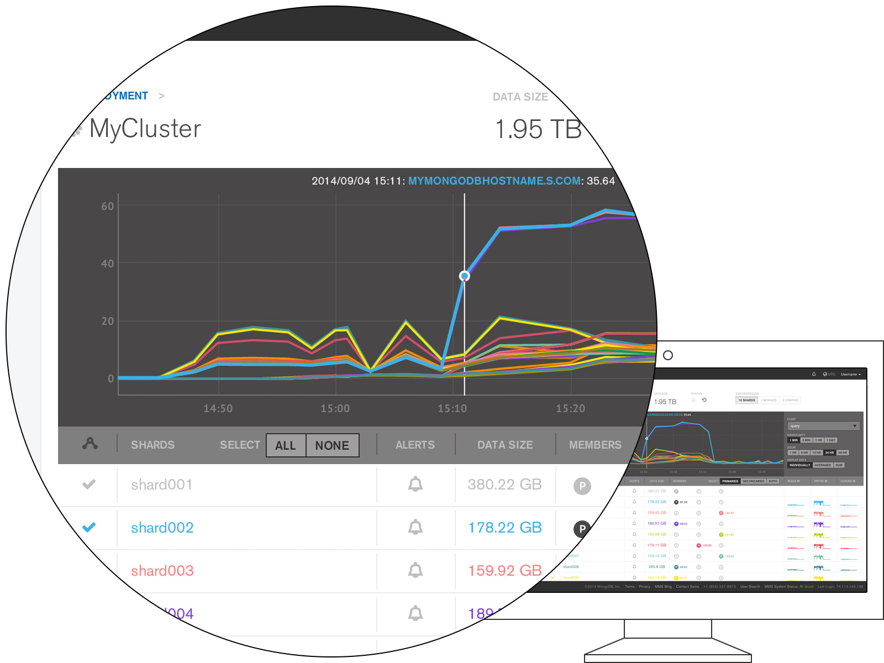
The Best Way to Run MongoDB
Ops Manager allows you leverage and automate the best practices we’ve learned from thousands of deployments in a comprehensive application that helps you run MongoDB safely and reliably.
10x-20x more efficient operations
Complete performance visibility
Protection from data loss
Performance optimization
Notes:
MongoDB Ops Manager can do a lot for [ops teams].
Best Practices, Automated. Ops Manager takes best practices for running MongoDB and automates them. So you run ops the way MongoDB engineers would do it. This not only makes it more fool-proof, but it also helps you…
Cut Management Overhead. No custom scripting or special setup needed. You can spend less time running and managing manual tasks because Ops Manager takes care of a lot of the work for you, letting you focus on other tasks.
Meet SLAs. Automating critical management tasks makes it easier to meet uptime SLAs. This includes managing failover as well as doing rolling upgrades with no downtime.
Scale Easily. Provision new nodes and systems with a single click.

Slide 69
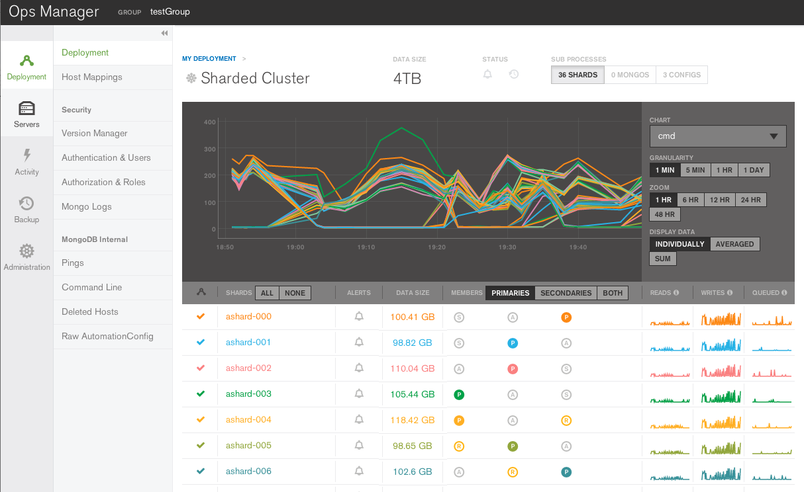
How Ops Manager Works
Ops Manager
Agent
Agent
Agent
mongod
mongod
mongod
Notes:
Ops Manager agents are installed on servers (where MongoDB will be deployed), either through configuration tools such as Chef or Puppet, or by an administrator.
The administrator creates a new design goal for the system, either as a modification to an existing deployment (e.g., upgrade, oplog resize, new shard), or as a new system.
The agents periodically check in with the Ops Manager central server and receive the new design instructions.
Agents create and follow a plan for implementing the design. Using a sophisticated rules engine, agents continuously adjust their individual plans as conditions change. In the face of many failure scenarios – such as server failures and network partitions – agents will revise their plans to reach a safe state.
Minutes later, the system is deployed – safely and reliably.

Slide 70
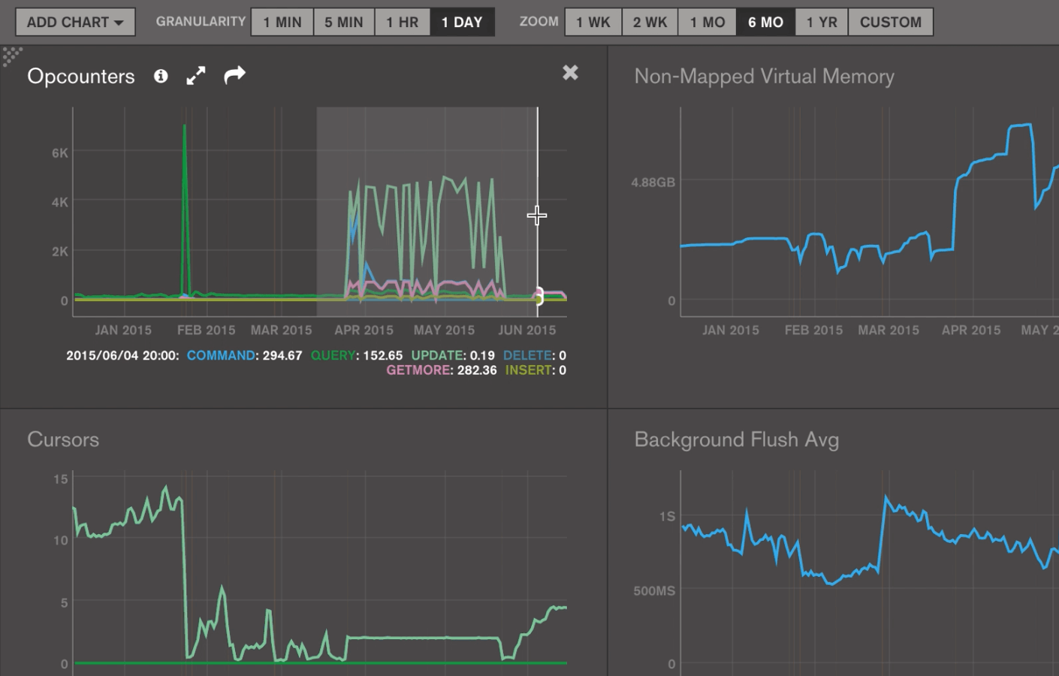
Monitoring & Alerting
Over 100+ database-related metrics
Dozens of optimized charts
Custom alerts so incidents do not become emergencies
Notes:
Ops Manager monitors 100+ metrics that could impact the performance of your database
Track key performance indicators across dozens of optimized charts
Build customized alerts that trigger when metrics are out of range; have them delivered how you want

Slide 71
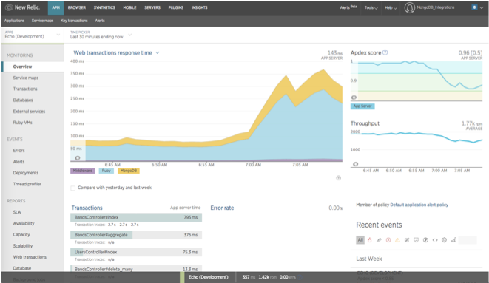
APM Integration
Monitor MongoDB alongside the rest of your app infrastructure by using our RESTful API
Leverage packaged integrations with leading APM platforms such as New Relic
Notes:
RESTful API to monitor MongoDB alongside the rest of your application infrastructure, from a single “pane of glass”
Packaged integrations with leading APM platforms such as New Relic now available with MongoDB Cloud Manager

Slide 72
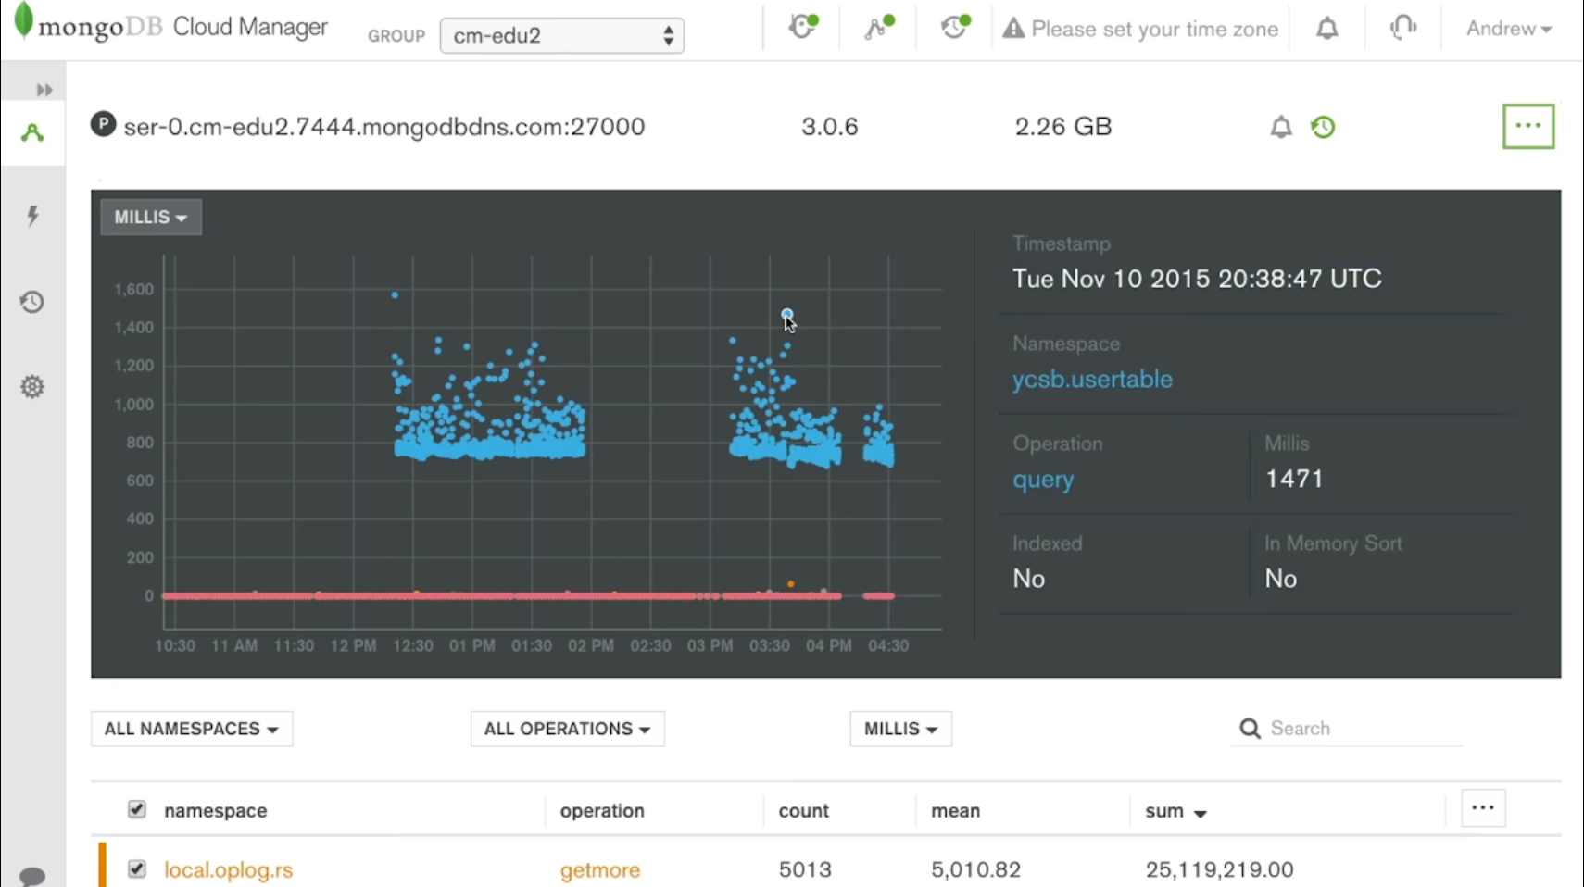
Visual Query Profiler
Identify the slow-running queries across your cluster with just the click of a button
Notes:
Quickly identify your slow-running queries.
Part of MongoDB Ops Manager, the Visual Query Profiler displays how query and write latency vary over time
With the click of a button, the Visual Query Profiler consolidates and displays metrics from all the nodes in your cluster on a single screen

Slide 73
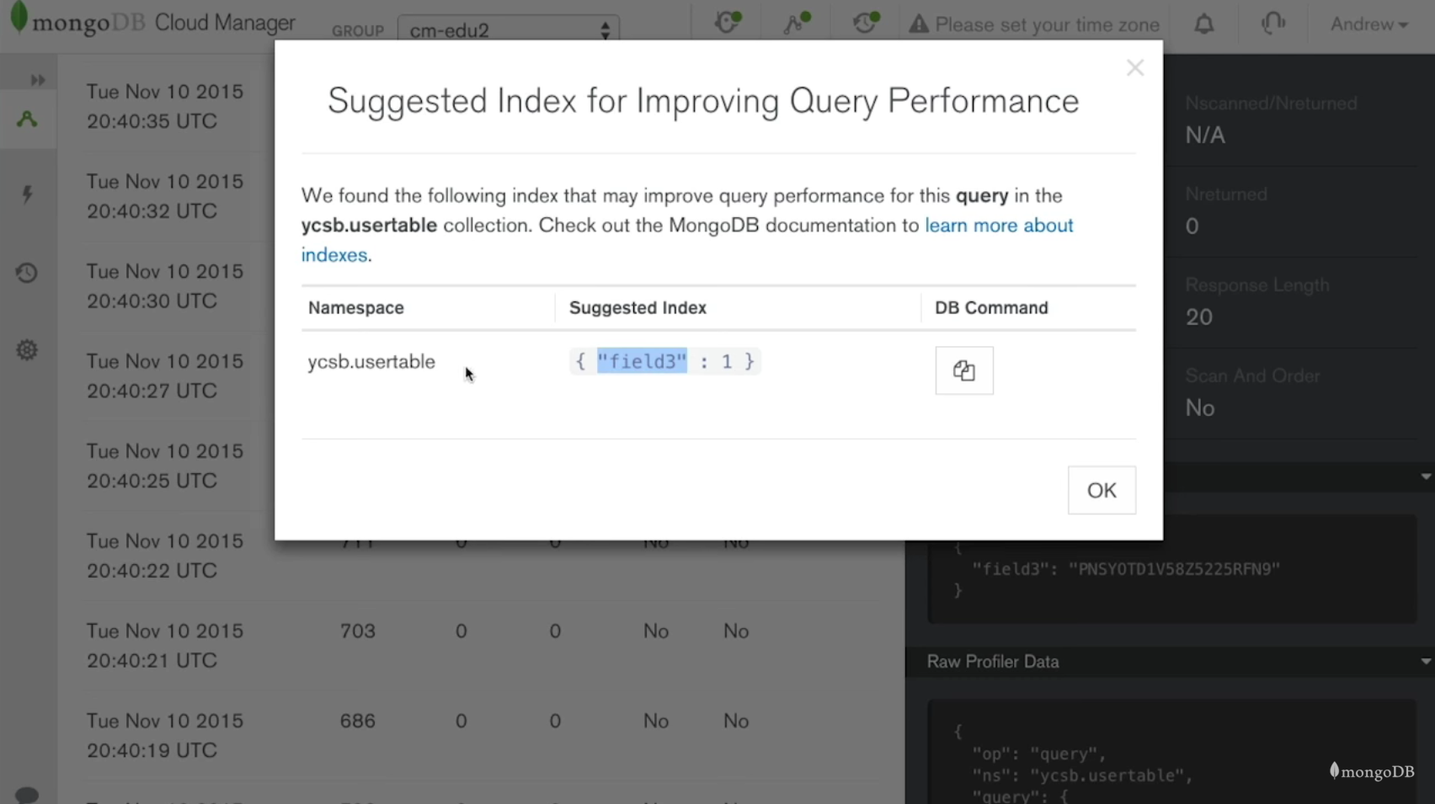
Index Suggestions
Index suggestions to improve your query performance
Notes:
The Visual Query Profiler analyzes the data it displays and presents recommendations for new indexes that can be created to improve the performance of your deployment.

Slide 74
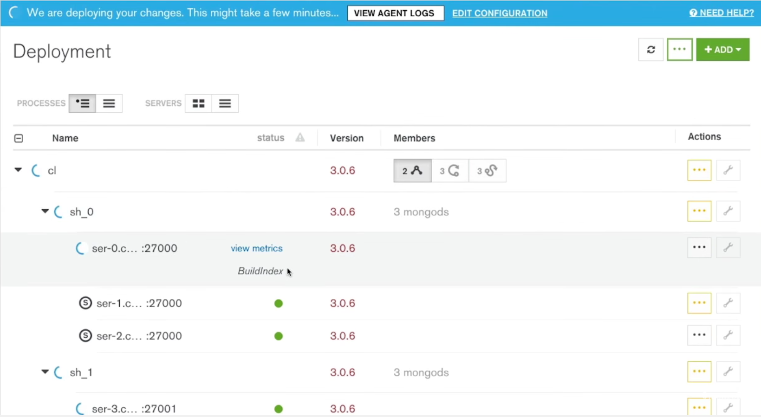
Automated Index Builds
Automate rolling index builds to reduce operational overhead and the risk of failovers
Notes:
The best practice for adding new indexes to your deployment is a rolling index build – starting with each of the secondaries and finally applying changes to the original primary, after swapping its role with one of the secondaries.
Ops Manager can automate this process across your replica sets, reducing your operational overhead and the risk of failovers caused by incorrectly sequencing management processes.

Slide 75
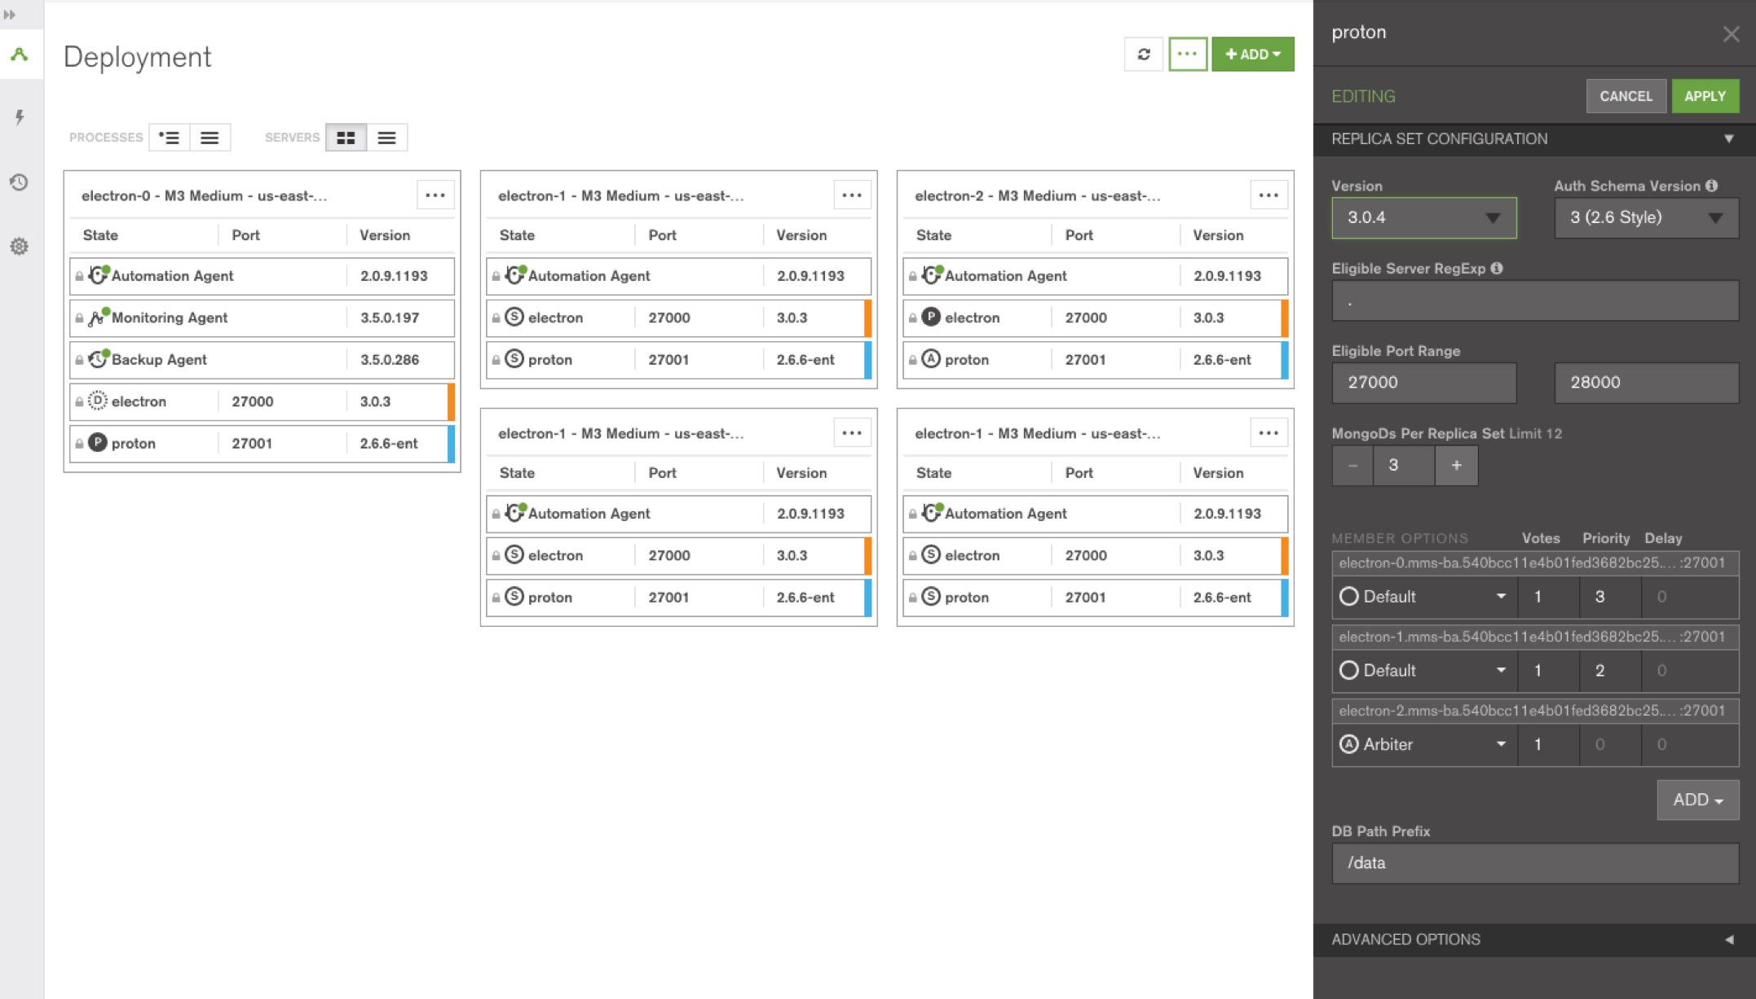
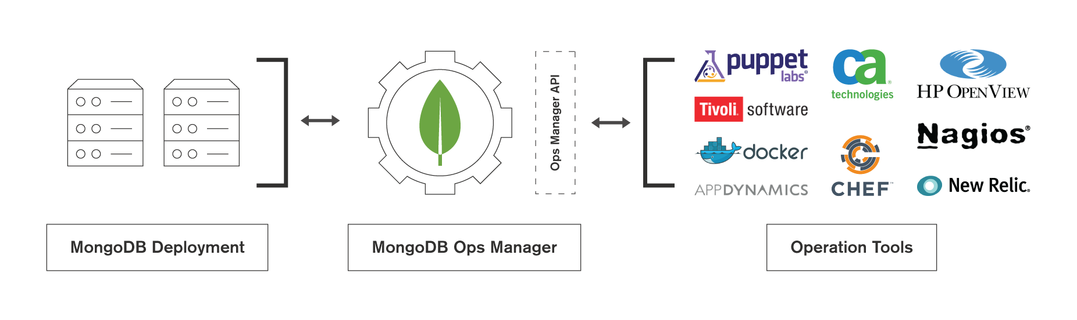
Database Automation
Automate tasks that you would have otherwise performed manually, such as…
Deploying a new cluster
Upgrades
Adding capacity
Database restores
Notes:
Ops Manager coordinates and orchestrates critical operational tasks across the servers in a MongoDB system. Tasks that you would have otherwise performed manually, such as…
Deploying a new cluster
Upgrades
Adding capacity
Database restores
Use the Ops Manager UI directly, or invoke the Ops Manager RESTful API from your existing enterprise orchestration frameworks, such as Chef, Puppet, etc.

Slide 76
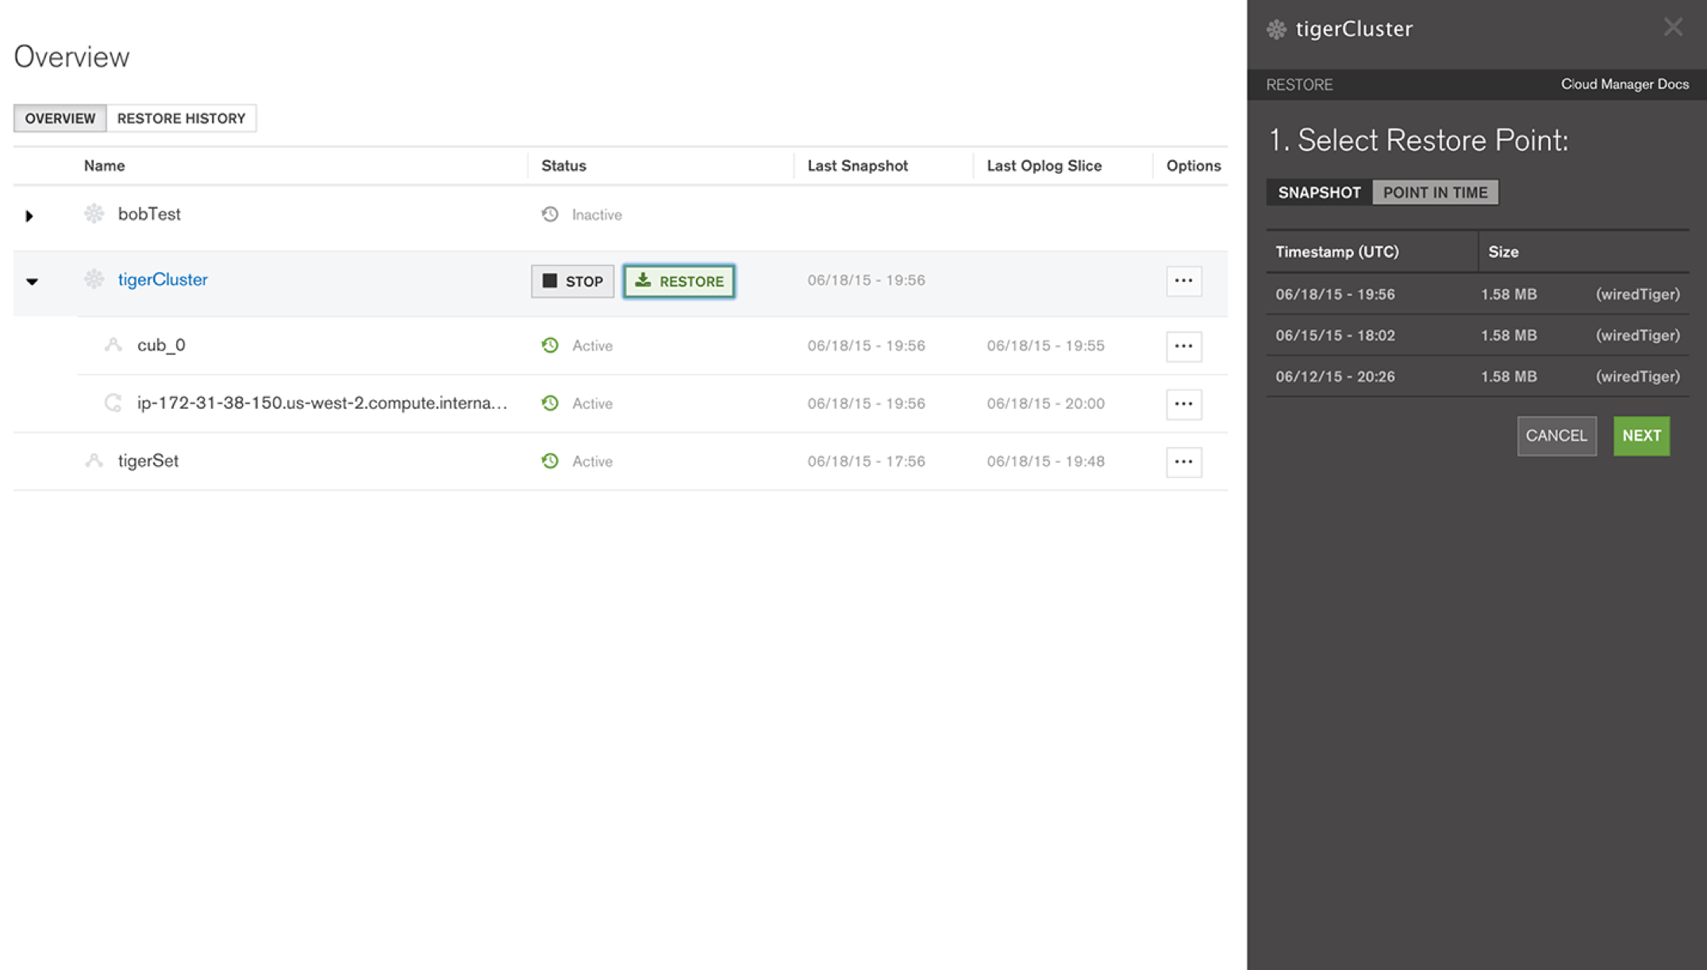
Backup with Point-in-time Recovery
Cluster-wide snapshots of sharded clusters
Restore to precisely the moment you need, quickly and safely with point-in-time restores
Notes:
Restore to precisely the moment you need, quickly and safely.
Ops Manager is the only MongoDB backup solution that offers point-in-time backups of replica sets and cluster-wide snapshots of sharded clusters.
Integrates with standard network-mountable file systems
Backups can be configured against specific collections, rather than the entire database

Slide 77
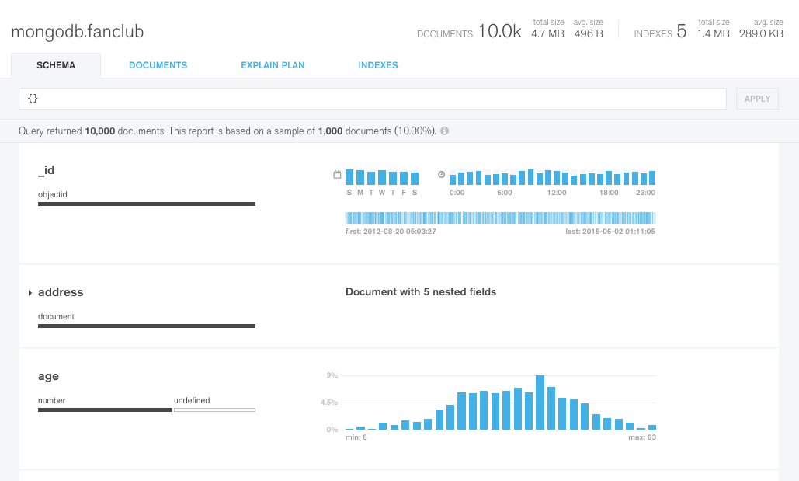
MongoDB Compass
The GUI for MongoDB
Visualize &
Explore
Insert, Modify, &
Delete
Debug &
Optimize
Visualize & explore your schema with an intuitive GUI
Gain quick insights about your data with easy-to-read histograms
Build queries with a few clicks
Drill down to view individual documents in your collection
Insert new documents or clone existing documents
Modify documents in place using the powerful visual editor
Delete documents in just a few clicks
Understand and resolve performance issues with visual explain plans
Check index utilization
Visual explain plans and full CRUD functionality are currently in beta.

Slide 78
MongoDB Compass
Visualize and explore
Visually explore the structure of your data to understand the schema and identify anomalies
Gain insights with histograms that display the distribution of values across your fields
Perform ad hoc complex queries with just a few clicks
Notes:
Key Takeaway: MongoDB Compass allows you to Understand your data and Perform ad hoc queries with No shell and no knowledge of the MongoDB query language required.
Talking points:
Graphical view of MongoDB schema from a sample of documents within a collection
Perform queries with a few clicks; get results graphically and as a set of JSON documents
Minimal overhead; fast and interactive experience no matter how large the database

Slide 79
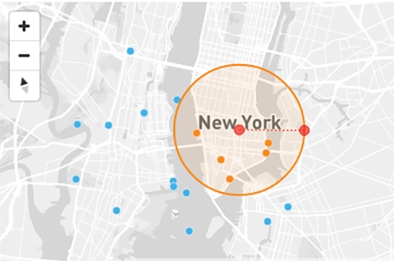
MongoDB Compass
Visualize and explore: Interactive maps for geospatial data
MongoDB Compass is the best way to visualize, understand, and work with your geospatial data.
Compass detects your geospatial data and populates it on an interactive map
Automatically generate geospatial queries by drawing on the interactive map with your mouse
Use Compass to significantly reduce the effort required when working with geospatial data
Interactive maps for geospatial data are currently in beta.

Slide 80
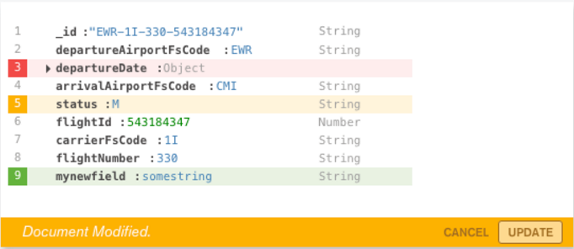
MongoDB Compass
Insert, modify & delete: Full CRUD functionality
Modify your data using MongoDB Compass.
Insert new documents or clone existing documents
Modify existing documents with greater confidence using the powerful visual editor
Delete documents in just a few clicks
Full CRUD functionality is currently in beta.

Slide 81
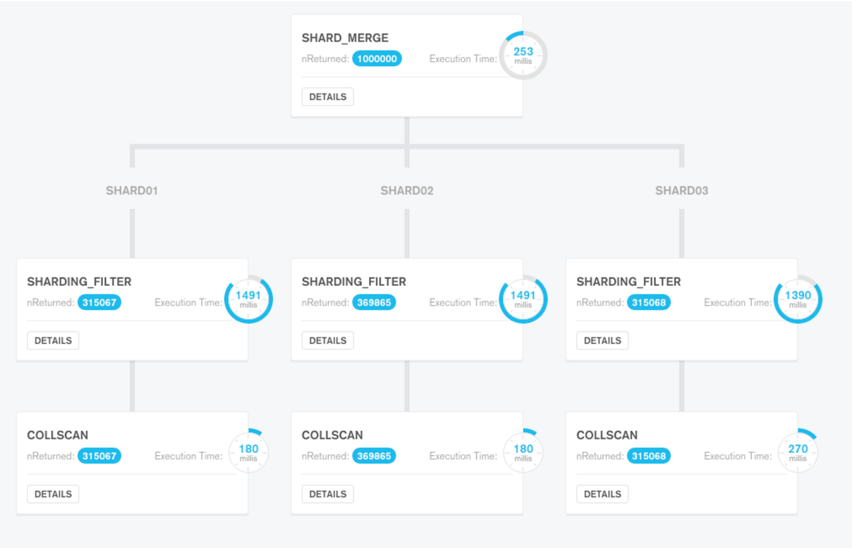
MongoDB Compass
Debug and optimize: Visual explain plans
Understand how queries are running through a GUI that allows you to easily identify and resolve performance issues.
View key information about the execution plan of a query
Visualize different explain stages in an easy-to-understand tree format
Visual explain plans are currently in beta.

Slide 82
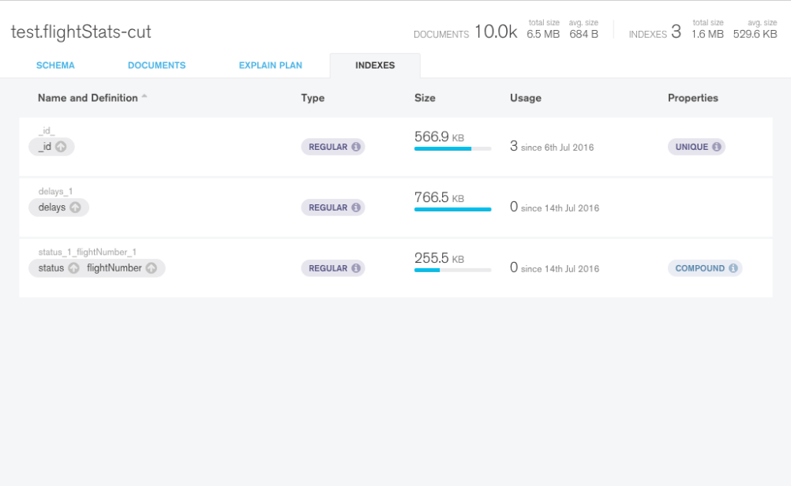
MongoDB Compass
Debug and optimize: Index details
MongoDB Compass allows you to view index details for a given collection:
Type of index: regular, text, geospatial, or hashed
Size of index: how much space the index uses
Index utilization: how many times the index has been used
Special properties: unique index, compound index, etc.

